Slide 1
Outline
Outline
Xử lý tín hiệu âm thanh
Miền thời gian miền tần số
Mel Filter banks
MFCCs

Slide 2
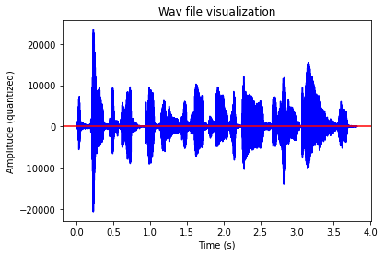
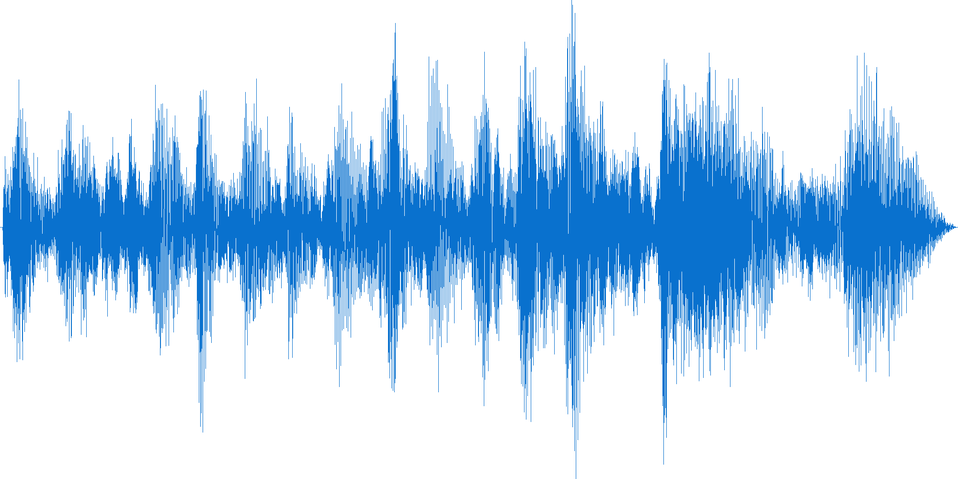
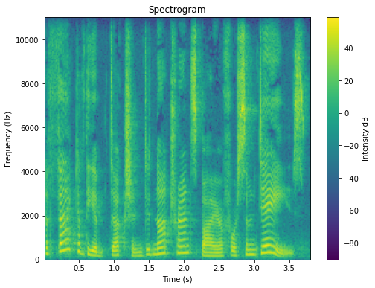
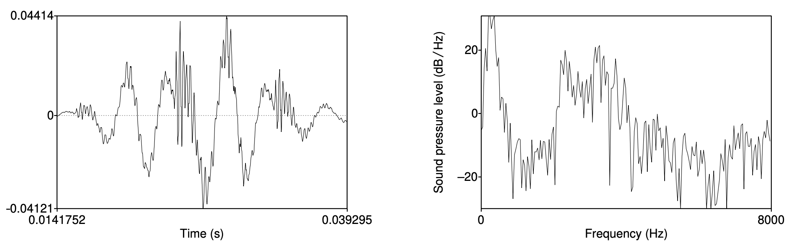
Basic Audio Preprocessing Pipeline
Time-domain representation
Input .wav file
1. Sampling
2. Quantization
3. FFT
Spectrogram
Frequency-domain representation
4. Extracting Spectrogram
The data preprocessing process

Slide 3
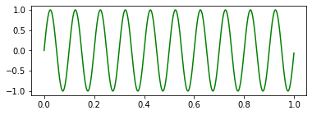
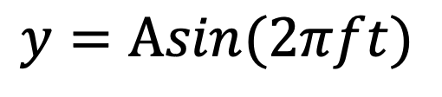
Audio Preprocessing
Audio Signals: Waves
$$y=Αsin(2πft)$$
Cycle
Amplitude
10 cycles in 1 second = 10 Hertz

Slide 4
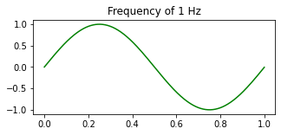
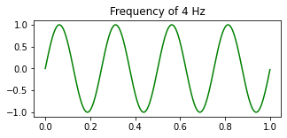
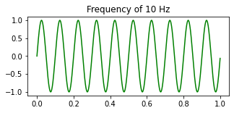
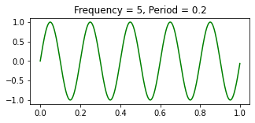
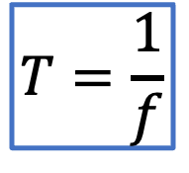
Audio Preprocessing
Audio Signals: Frequency & Period
$$T=\frac{1}{f}$$

Slide 5
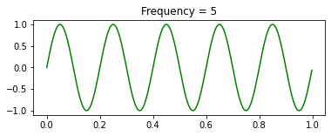
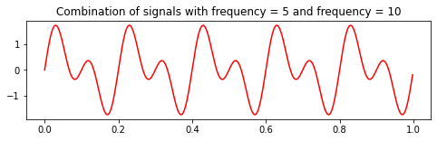
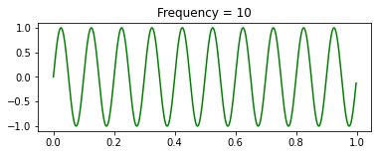
Audio Preprocessing
Audio Signals

Slide 6
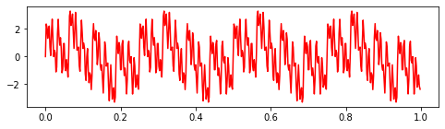
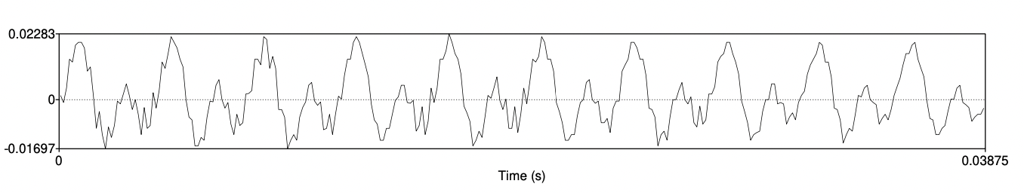
Audio Preprocessing
Audio Signals
Audio signals are complex combination of sub-signal waves (e.g: sine/cosine...)
Waveform of vowel [iy]

Slide 7

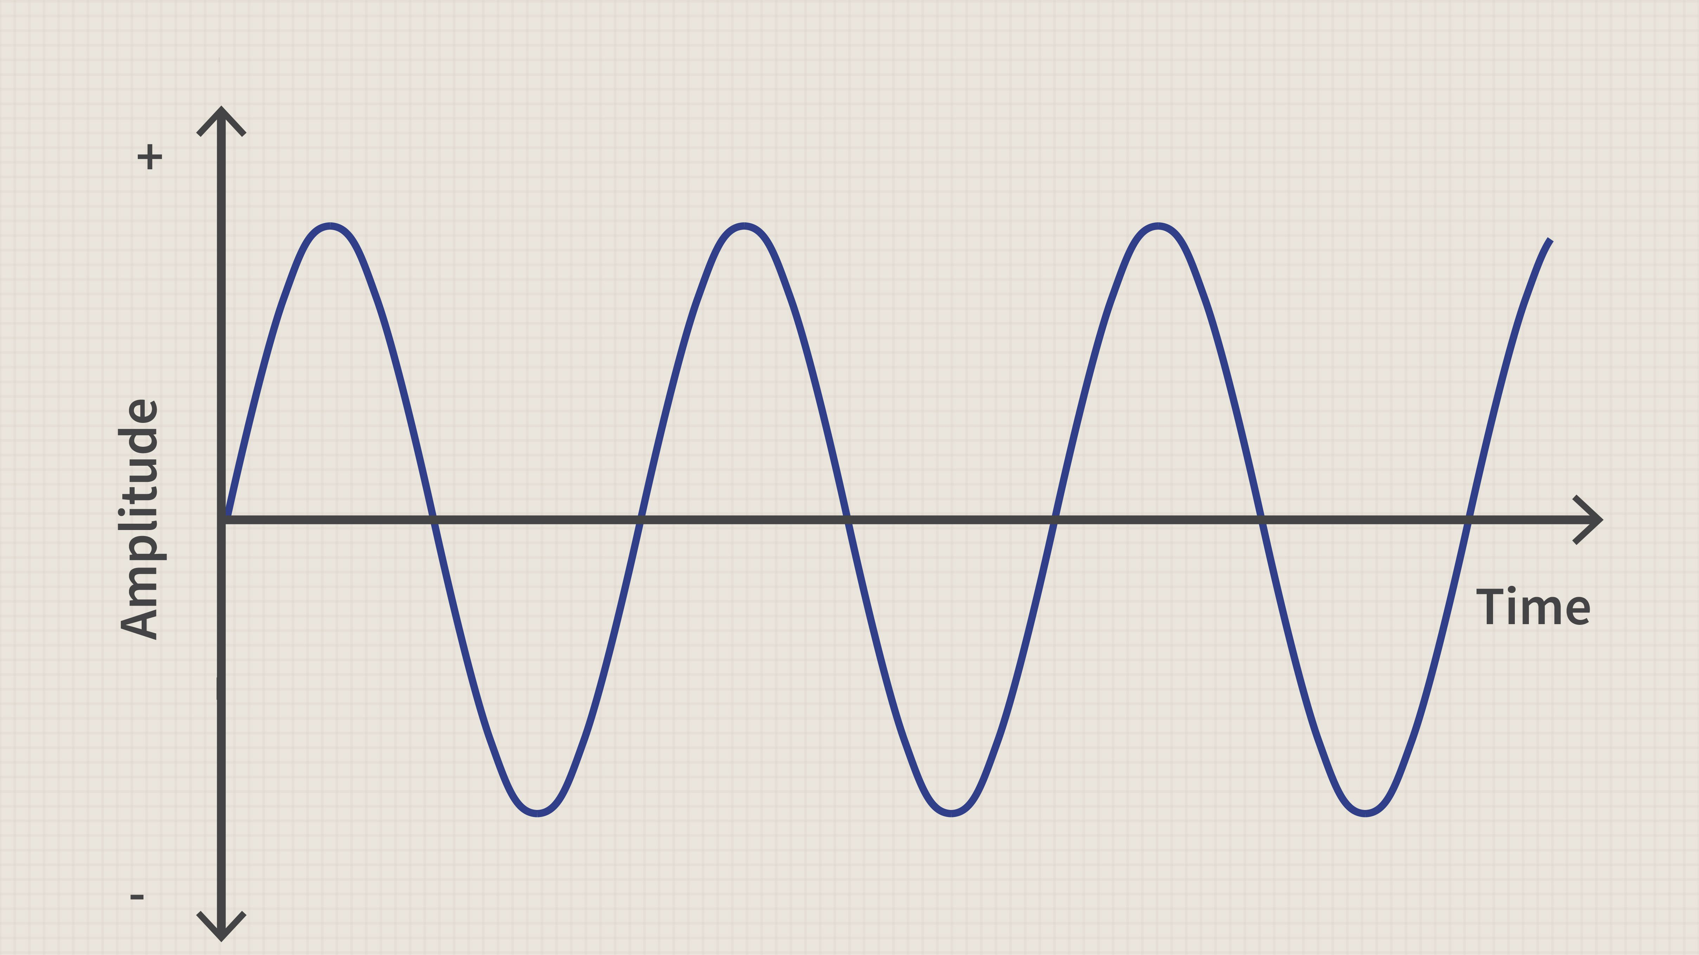

Audio Preprocessing
Analog-to-digital conversion
Mechanical wave energy (sound wave)
Transducer (e.g microphone...)
Electrical energy (analog audio signal)
The process of recording sound waves (speech, music...)

Slide 8
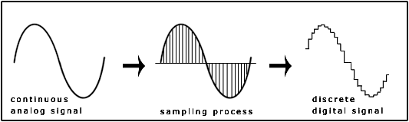
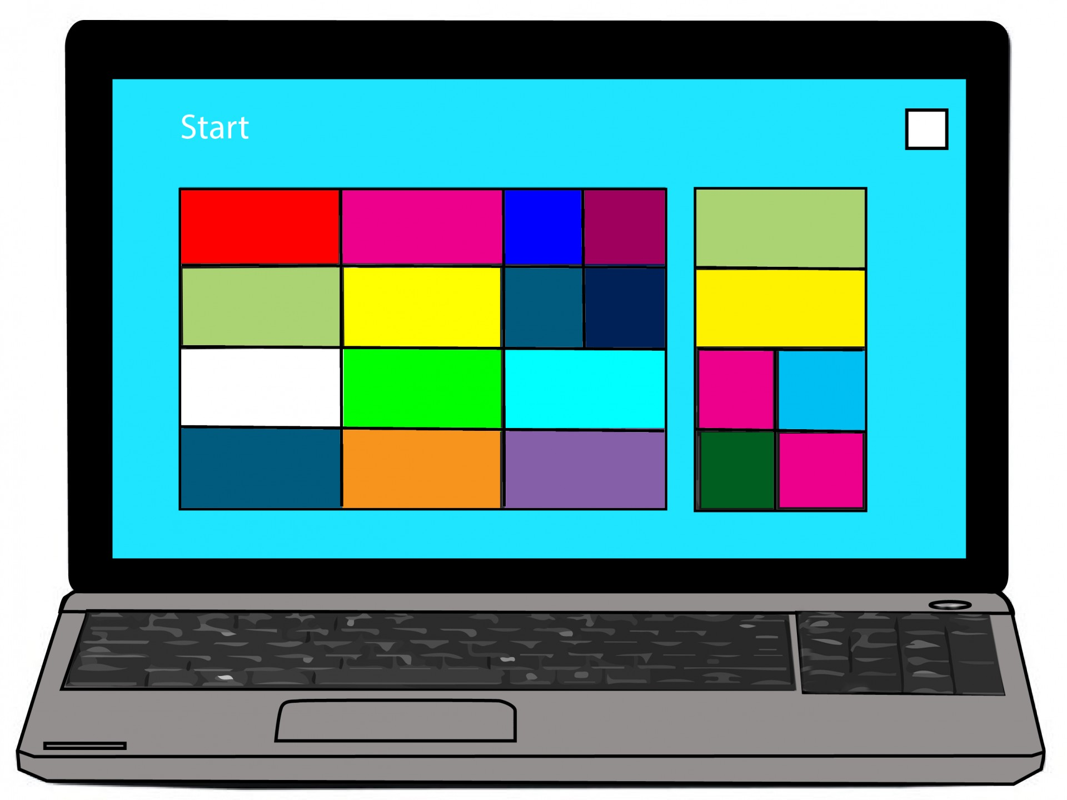
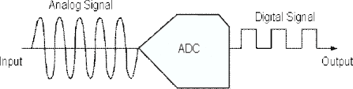
Audio Preprocessing
Analog-to-digital conversion
COMPUTER CAN’T READ ANALOG SIGNAL !!!
Convert analog representations into a digital signal

Slide 9
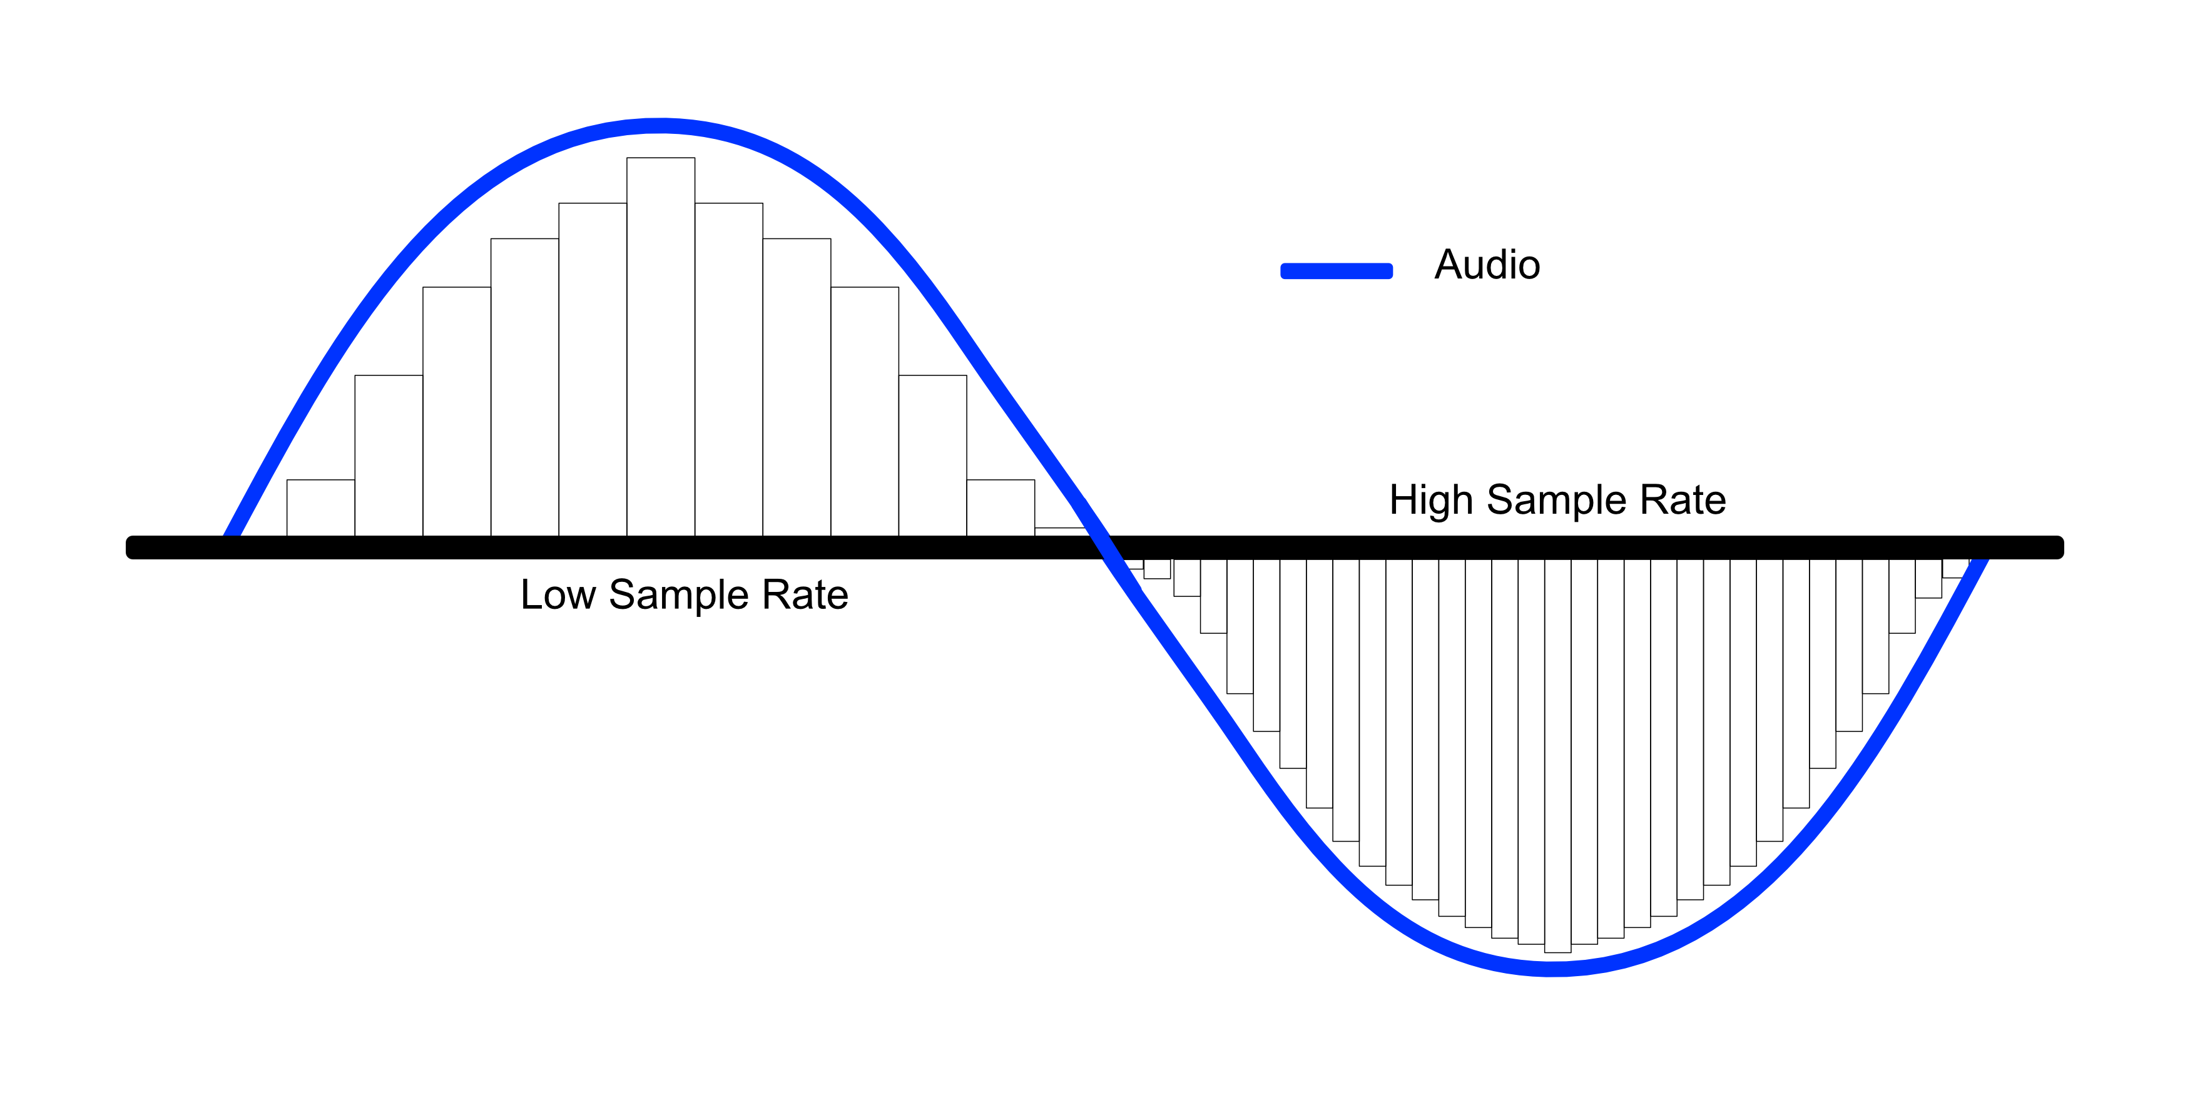
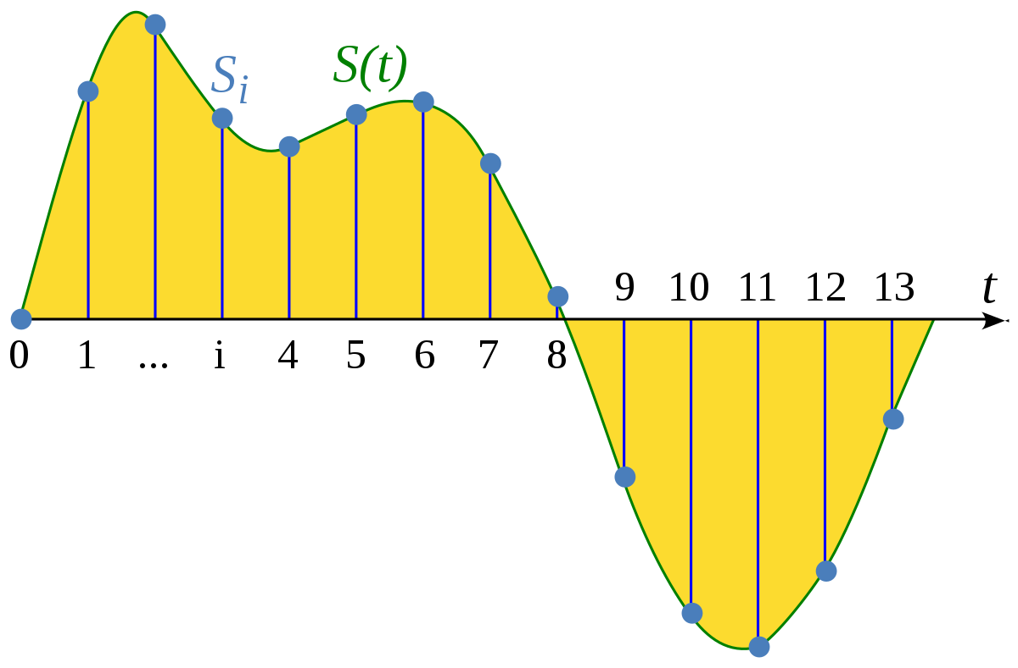
Audio Preprocessing
Sampling
A signal is sampled by measuring its amplitude at a particular time
Sampling rate (sampling frequency): number of samples taken per second

Slide 10
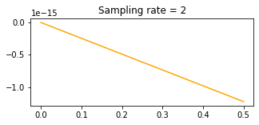
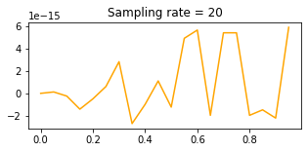
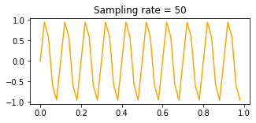
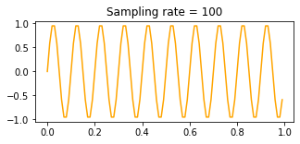
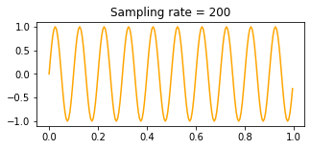

Audio Preprocessing
Sampling

Slide 11
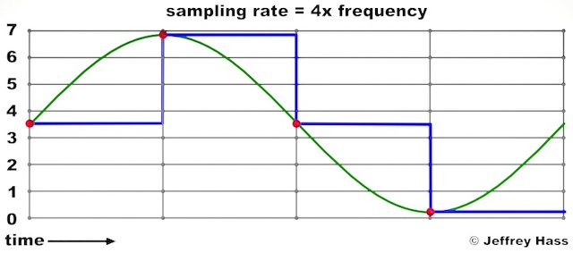
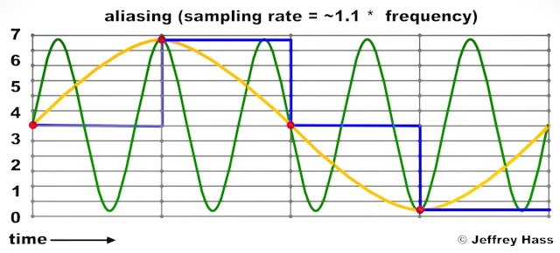
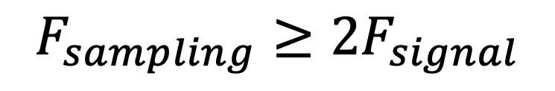
Audio Preprocessing
Sampling: Nyquist Theorem
$$F_{sampling}≥2F_{signal}$$

Slide 12
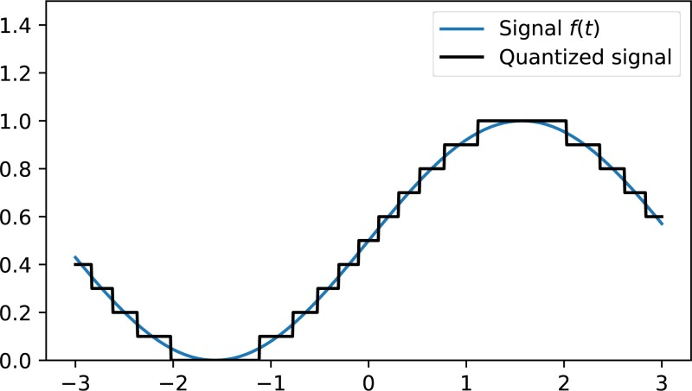
Audio Preprocessing
Quantization
Mapping continuous infinite values to discrete finite values (real-valued numbers to integers)

Slide 13
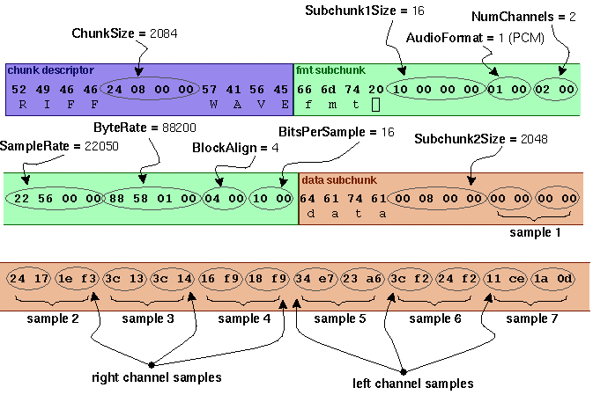
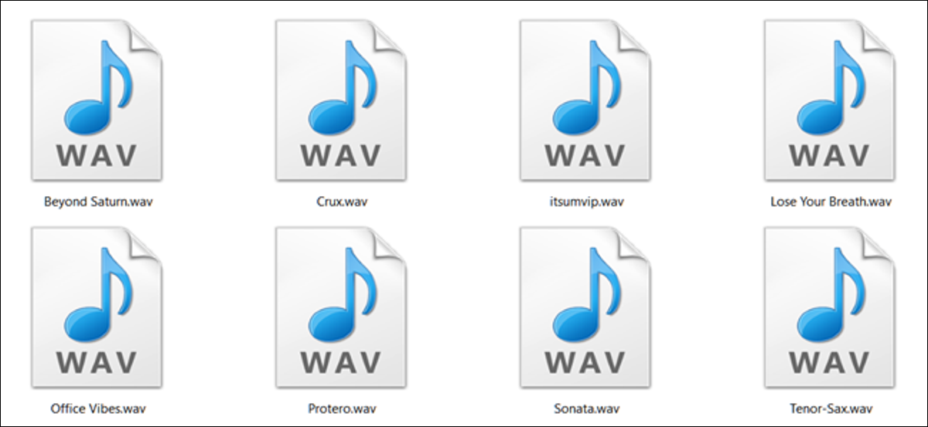
Audio Preprocessing
Wavefile format
Example: Microsoft wavefile format

Slide 14
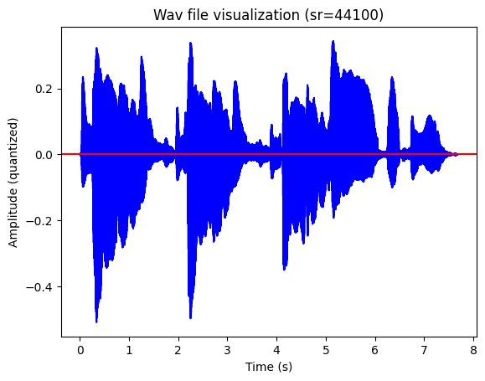
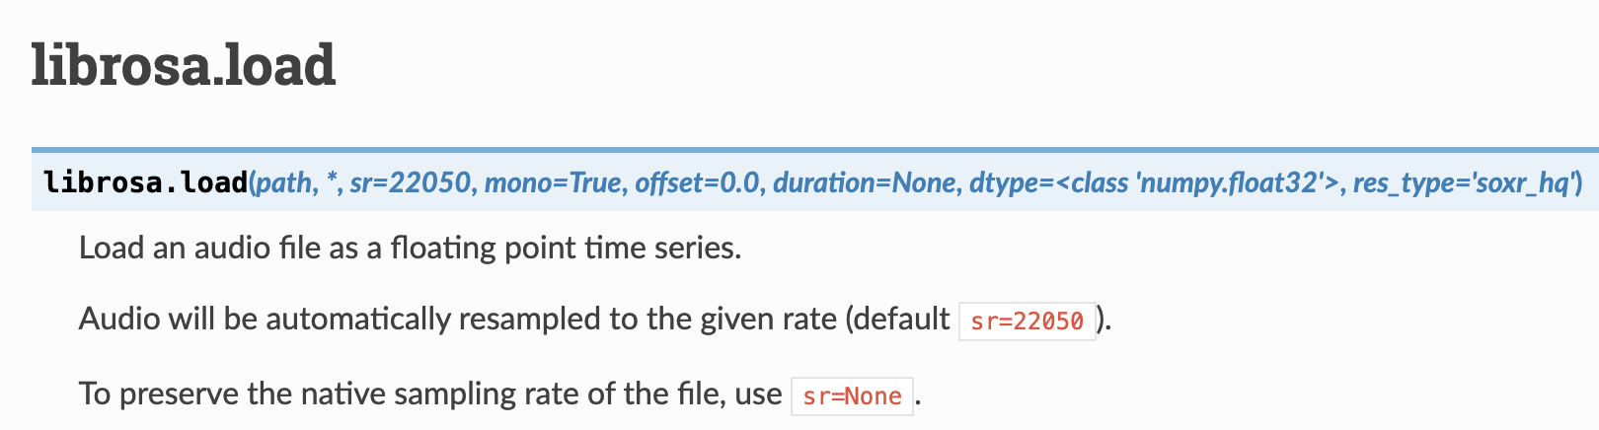
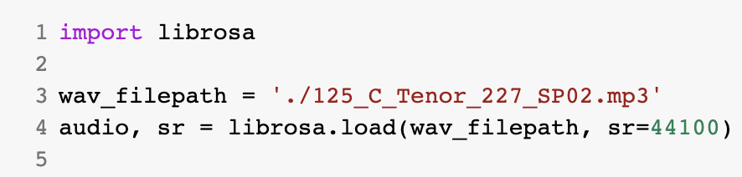
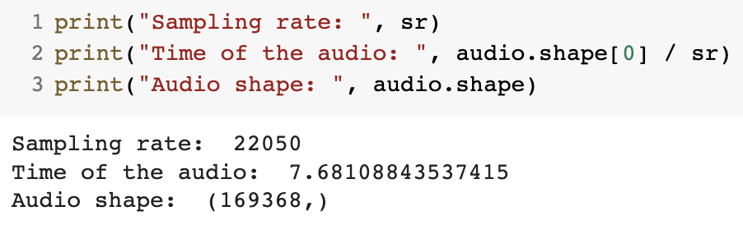
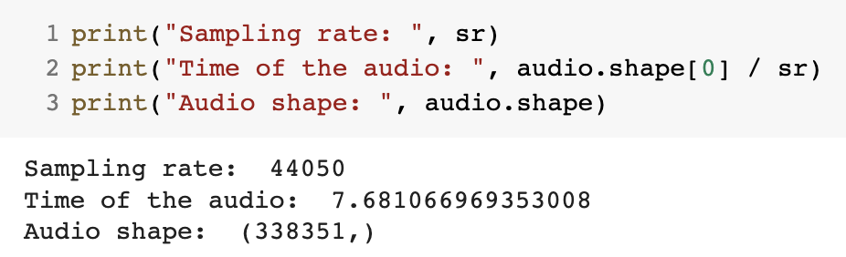
Audio Preprocessing
Read wavefile: Default Resampling
Sampling rate = 22050
Sampling rate = 44100

Slide 15
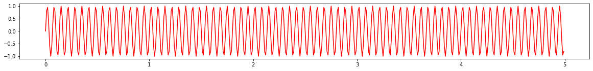
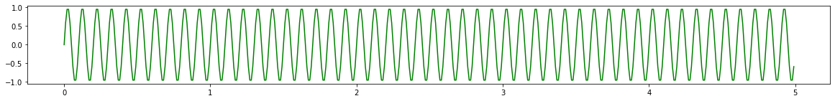
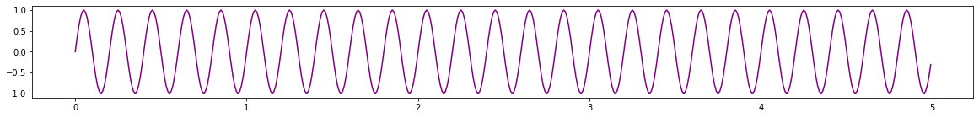
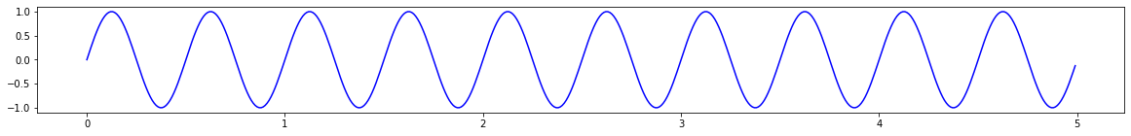
Time-domain & Frequency-domain
Time-domain & Frequency-domain
Time-domain
Amplitude
Frequency
Frequency-domain
Time

Slide 16
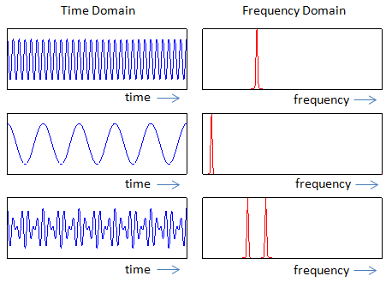
Time-domain & Frequency-domain
From Time-domain to Frequency-domain

Slide 17
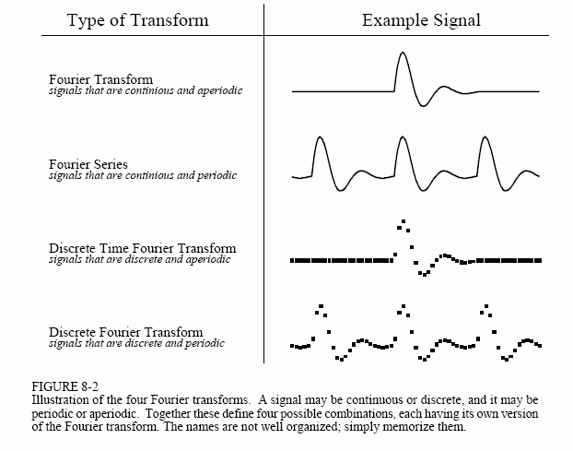
Time-domain & Frequency-domain
Type of Fourier Transform

Slide 18
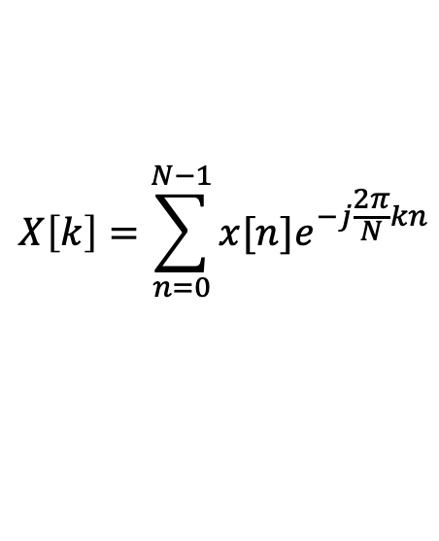
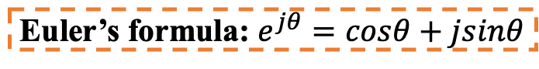
Time-domain & Frequency-domain
Discrete Fourier Transform
Amplitude over time
Magnitude over frequency (spectrum)
Euler’s formula: $e^{jθ}=cosθ+jsinθ$
$$X\left[k\right]=\sum_{n=0}^{N−1}{x[n]e^{−j\frac{2π}{N}kn}}$$

Slide 19
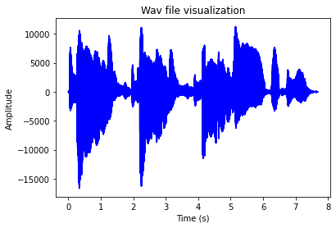
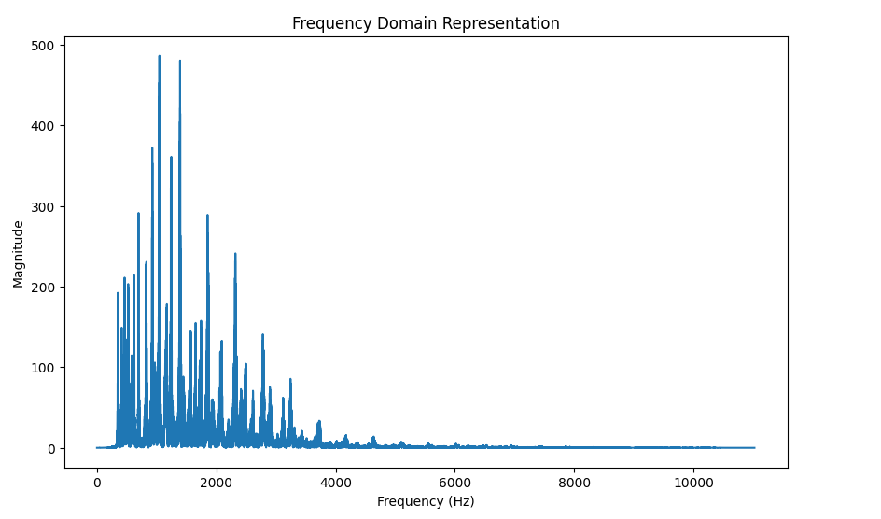

Time-domain & Frequency-domain
Spectrogram Visualization
Example of a saxophone sound

Slide 20
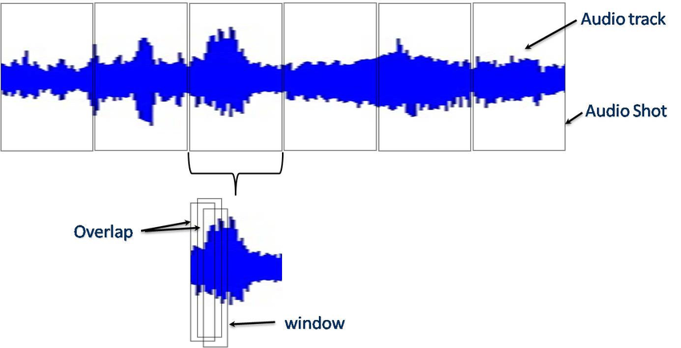
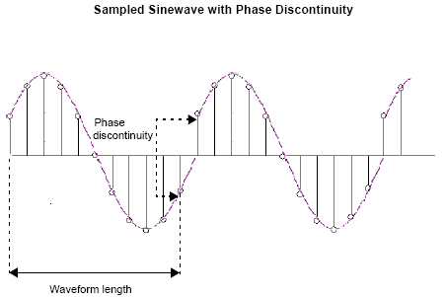
Time-domain & Frequency-domain
Windowing: Audio Discontinuity

Slide 21




Time-domain & Frequency-domain
Windowing: Shape
$$y\left[n\right]=w\left[n\right]s[n]$$
$$w\left[n\right]=\left\{\begin{aligned}1 0≤n≤L−1 \\ 0 otherwise\end{aligned}\right.$$
Raw window (rectangular):
$$w\left[n\right]=\left\{\begin{aligned}0.54−0.46\cos\left(\frac{2πn}{L}\right) 0≤n≤L−1 \\ 0 otherwise\end{aligned}\right.$$
Hamming window:
$$w\left[n\right]=\left\{\begin{aligned}0.54(1−cos\left(\frac{2πn}{L}\right)) 0≤n≤L−1 \\ 0 otherwise\end{aligned}\right.$$
Hanning window:

Slide 22


Time-domain & Frequency-domain
Windowing: Shape

Slide 23

Time-domain & Frequency-domain
Spectrogram Visualization
Example of a saxophone sound

Slide 24




Time-domain & Frequency-domain
Sound Intensity
$$power=\frac{1}{N}\sum_{i=1}^{n}{x_{i}^{2}}$$
$$Intensity=10\log_{10}{\frac{power}{P_{0}}} \left(db\right); P_{0}=2×{10}^{−5}$$

Slide 25


Mel Filter Bank
Mel Filter Bank
Problem: human can only hear in a limited range of frequency.

Slide 26


Mel Filter Bank
Mel Filter Bank
Solution: collecting energy of signals in a mel scaled range.
$$mel\left(f\right)=1127ln⁡(1+\frac{f}{700})$$
Triangular filters: fine resolution at low frequency, less at high frequency

Slide 27


Mel Filter Bank
Pitch
Pitch (in music): position of a single sound in the complete range of sound
Case 1: From C2 to C4 (65 to 262)
Case 2: From G6 to A6 (1568 to 1760)
Both are 200 Hz differ between 2 notes.

Slide 28

Mel Filter Bank
Mel Filter Bank
$$mel_{1}$$ | $$mel_{2}$$ | $$mel_{3}$$ | $$mel_{4}$$ | ... | $$mel_{n_filters}$$
mel spectrum

Slide 29


Audio Preprocessing (2)
AI VIETNAM
All-in-One Course
(TA Session)
Mel Filter Bank

Slide 30




MFCCs
Mel-Frequency Cepstral Coefficients (MFCCs)
Power Spectrum of a window
Log-spectrum of a window

Slide 31

MFCCs
Mel-Frequency Cepstral Coefficients (MFCCs)

Slide 32


MFCCs
Mel-Frequency Cepstral Coefficients (MFCCs)

